Slide 1
Managing Logistics for Rural and Arctic Construction in Alaska
November 21, 2018

Slide 2
Unique Alaskan Challenges
Size of our state
Short construction seasons
Lack of a road system to many communities
Vastly different environments all within the state
Notes:
BROOKE
These items might be overstating the obvious, but these considerations are many times overlooked.
Size of Alaska:
656,425 sq. miles, 1400 miles long and 2700 miles wide.
33,900 miles of shoreline, which is 50% more than the entire continental US.
Vastly different environments from one end of the state to the next.
Short Construction Seasons:
Summer
Ice Roads, Dependent on season, but typically available from January to March. (Check w/ Adam.)
Spring road weight restrictions, Typically can occur b/w April to June. Inevitably, these catch a few projects by surprise each year.
Lack of a Road System:
As soon as a project is not on the road system, your modes of transportation begin to increase. The consideration of seasons, barging schedules, and air facilities (runways) become much greater.
Different Environments Across the State:
Variations in equipment, material needs, fuel considerations.
Different demands for preparedness. Rural and Arctic jobs will require a higher necessity of preparedness. Thus, capitalizing on the movement of as much of your freight at one time, can save tens of thousands of dollars. (??? Too vague???) (Provide a good example)
***Not pertaining to construction, but the Ketchikan basketball team flew to Barrow to play a division game. This would be the same as sending students from Vancouver, BC to San Diego, CA. Even those of us who live here sometimes lose sight of how vast and expansive our own state is.
***Anchorage to Deadhorse is 900 miles on our road system. Same as driving from Vancouver, BC to San Francisco, CA

Slide 3
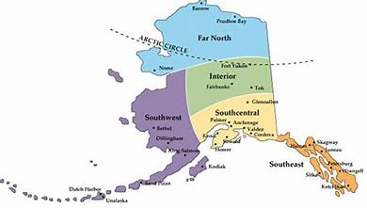
Modes of Transportation Per Region
Notes:
ADAM
–If we can find a better map for regions, we can swap this one out.
General Overview:
We are capable of servicing most any Alaskan community with some form of transportation, and many times, multiple modes of transportation. That said, the options become more limited outside of the Southcentral, Interior, and Southeast regions. Western and Northern Alaska present their own challenges with limited or no road system, unpredictable weather, harsh seasonal effects, and small populations. All of these factors severely limit the number of transportation options.

Slide 4
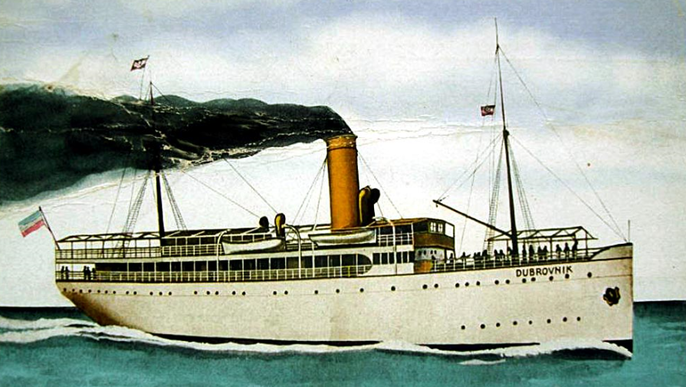
Modes—Southcentral & Southeast
Southcentral
Barge / Rail
Steam Ship
Truck
Southeast
Barge
Truck / Ferry
Notes:
BROOKE
--I will further elaborate on these items. Add expense comparison. Multi-modal, pay for speed you need, dynamic routing. Check on Dutch Harbor—Matson.
SOUTHCENTRAL
Barge—Full Truckload and LCL (Less than container load)—Regular weekly service out of Seattle, typically arriving in Whittier port. Railed from Whittier to ANC for further distribution. A handful of these barges will come into Anchorage each year to accommodate furtherance to Western communities and to accommodate larger freight that cannot travel through the Whittier tunnel. Typical travel time can range from about 8-12 days depending on season and weather.
Steamship—Full Truckload and LTL (Less than truckload)—Twice weekly sailings from Seattle to Anchorage by both Tote and Matson, departing Seattle every Wednesday and Friday. Matson does make a quick stop in Kodiak and Dutch Harbor once a week on their Southbound return, so freight from Anchorage to Kodiak can be added each week. Typical travel time from departure to delivery is 5-6 days for Anchorage deliveries.
Truck—Over the road—Twice weekly LTL service (Quick Trans) from Seattle to Anchorage. Team drivers departing Seattle every Tuesday and Friday evening, with Anchorage deliveries on Friday and Monday, respectively. The Friday departure also includes a truck to Fairbanks, which delivers in Fairbanks on Monday morning.
Full Truckload options are available upon request.
SOUTHEAST
Barge—Full Truckload and LCL —Once a week out of Seattle.
Truck –LTL —Weekly service from Anchorage to Haines, then barged or ferried for furtherance to Southeast communities.

Slide 5
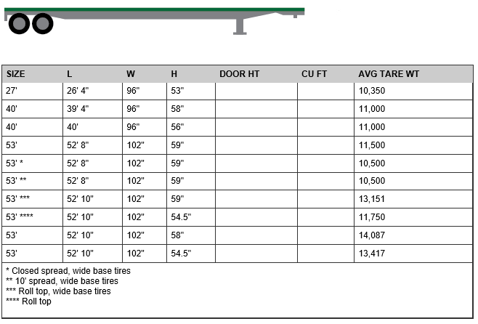
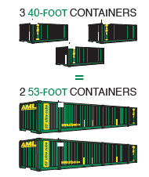

Slide 6
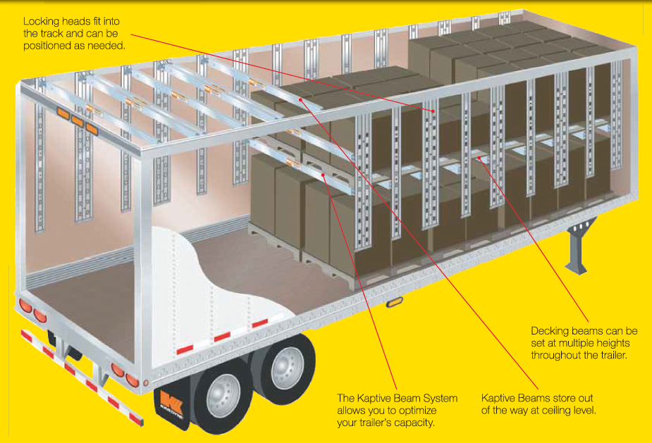
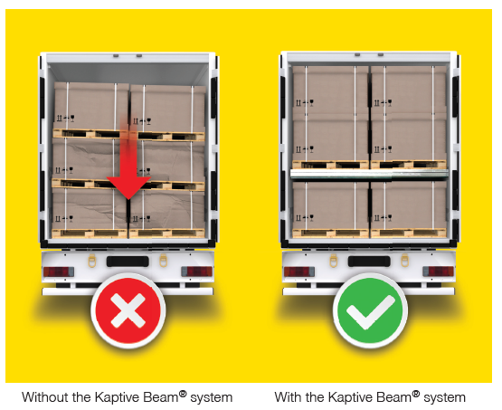

Slide 7
Modes—Western & Northern
Western Region
Air
Barge
Northern Region
Air
Barge
Snow/Ice Road
Notes:
ADAM
-We could show a Western barge schedule as an example, maybe an LAC scheduled service schedule as well.
WESTERN REGION
Summer Barge Sailings—9 scheduled sailings out of Seattle and Anchorage.
Weekly Air Service to Bethel, Nome, and Kotzebue.
NORTHERN REGION

Slide 8
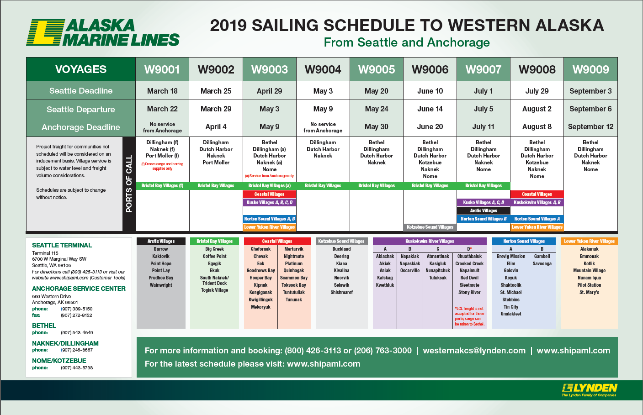

Slide 9
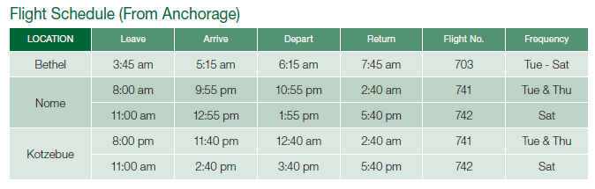
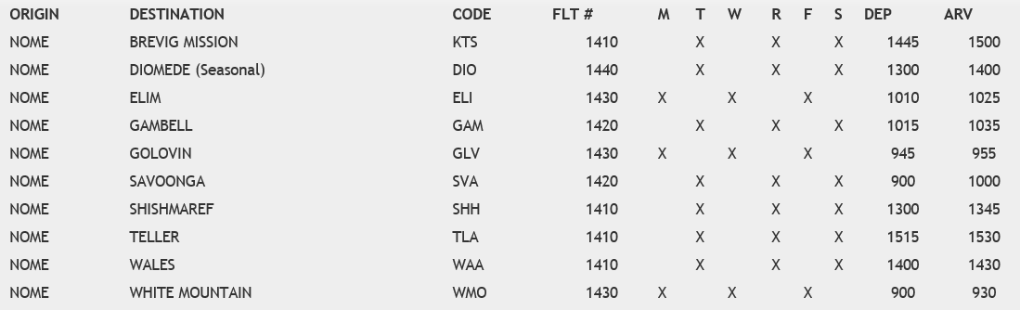

Slide 10
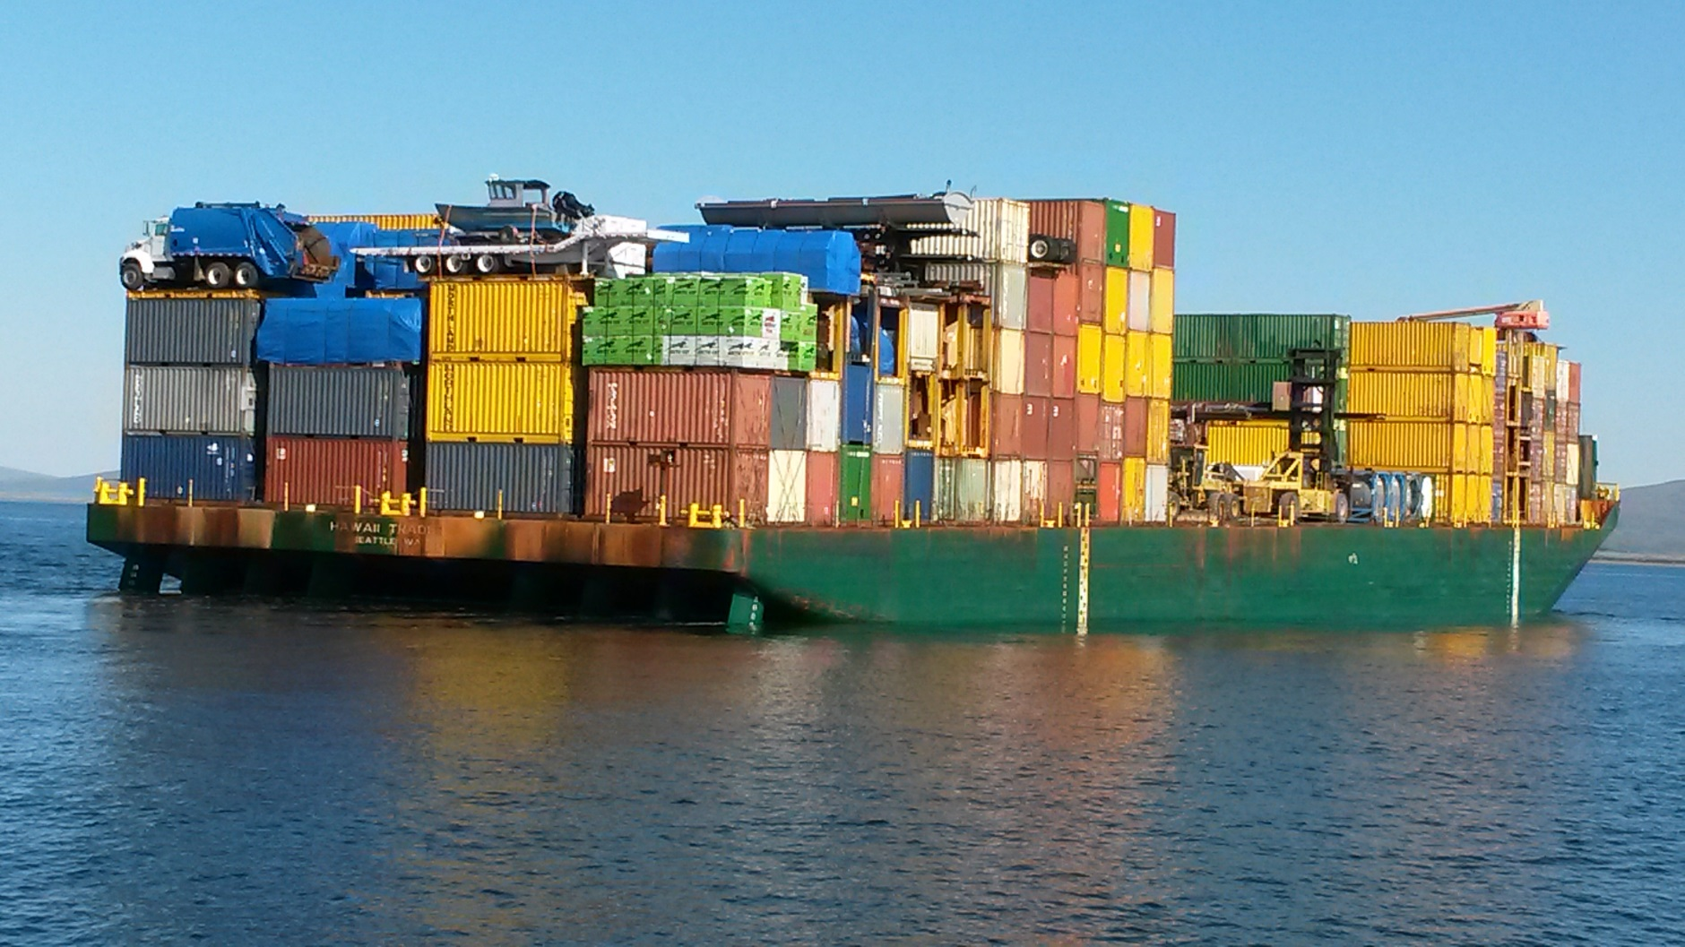
Barge Arriving in Nome

Slide 11
Considerations in Planning and Budgeting
Project location
Supplier location
Duration and timing of project
Liability—Dependent on each carrier
Notes:
Project Location—
What are the location’s geographical limitations?
What modes of transport are available? Is there a limitation due to seasonality?
Examples:
Acutan airport is actually on island of Acun (Salt slung by helicopter?)
“Need a truck to go to Dutch Harbor”
Supplier Location—
At beginning of 2018, a new federal rule went into effect, requiring Electronic Logging Devices, or ELDs on trucks. This costly investment was enough to cause many independent drivers to retire, and for many trucking companies who were on the edge to not be able to make the investment. Almost overnight, we started to see a driver shortage, and trucking prices across the Lower 48 began a steady rise.
It is now well worth the investigation of whether or not you are better sourcing materials closer to the Seattle/Tacoma ports.
While prices from SEA-AK will hold fairly steady over the course of the year, lower 48 trucks are consistently increasing. Fuel surcharge is another factor. (Elaborate)
California, 42,000# max
Duration and Timing of Project
When do you expect the project to start and end?
What season(s) will the construction take place? This will influence modes and other considerations such as great fuel use if needing to heat in the winter. (Adam’s Knik example)
Storage Space at Jobsite
Will you need to accumulate considerable materials and equipment at the jobsite before they can be utilized?
-Might incur detention of equipment or additional storage fees if material cannot be stored on site. Or if renting equipment, must account for considerable transportation time, and limited opportunities to return or retrieve equipment. (Might belong elsewhere.)

Slide 12
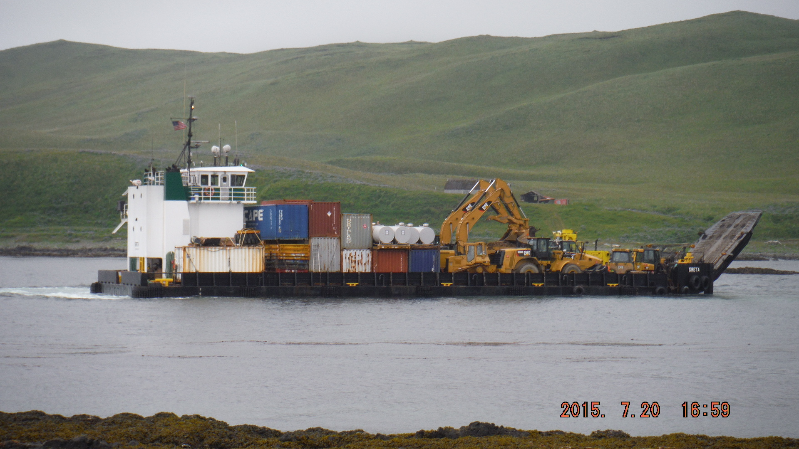

Slide 13
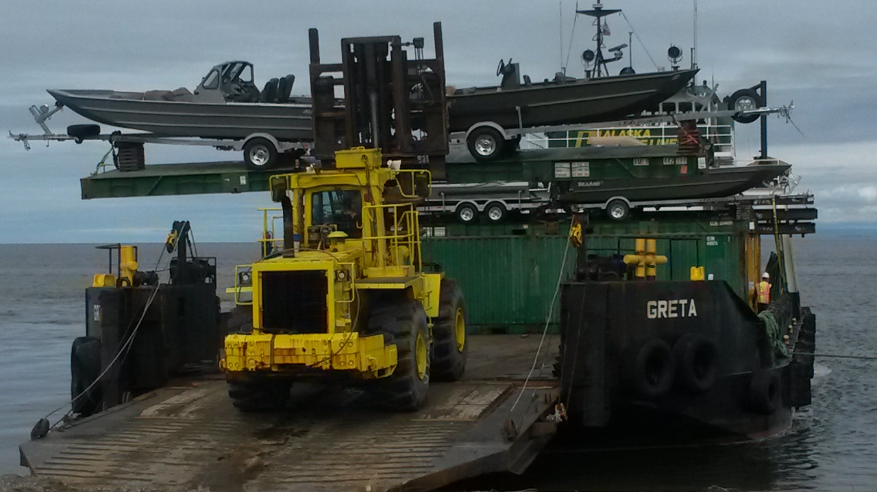
Landing Craft in Kotzebue

Slide 14
Proactive Logistics Plan carriers.
Early and Consistent Communication
Clear Instructions
The BOL (Bill of Lading) and AWB (Airway Bill) is your shipment’s life blood
Notes:
Having a plan, even if it needs to change as the project evolves:
Will save money.
Will cut down on mistakes and delays
Will be able to optimize shipping capabilities and potentially combine freight to further reduce costs.
Bill of Lading Clarity
(Maybe show a bill of lading completed?)
The legal tender for all carriers.
Possible Example:
Joists to False Pass/Eielson

Slide 15
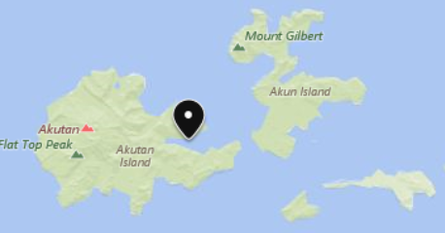

Slide 16
Educating Your Suppliers
Assume your suppliers do not understand Alaska
Alaska Freight = International Freight
Packaging
Notes:
Most of your suppliers have never been to Alaska, and have no concept of what it take to transport goods to the state, much less, build in this state.
Freight destined for Alaska should be considered international freight.
This freight will typically be handled and transferred across multiple modes of transportation before it reaches it’s final destination.
Your freight could drive across pot-holed roads, move on open ocean boats that may be exposed to salt spray, may sit on a frozen tarmac, and will most certainly be handled by multiple individuals along the way.
Spending a little more time explaining your packaging needs, and even paying for better packaging could easily pay for itself.

Slide 17
Designing for Arctic and Rural Projects
Dimensional constraints
Necessary equipment to assemble
MODS—Consult w/ freight company before finalizing design
Notes:
What are the project’s requirements, and how do you design and plan for your applicable transportation mode(s)?
Dimensional Constraints:
Herc limitations
ANC-PBY truck limitations?
MODS
Fail Example: Mods were built in Edmonton and then transportation was arranged. No OTR or water option could be found to move them out of Edmonton. They have been sitting completed for two years. The company is now looking into cutting the MODs apart, shipping them in pieces, and reassembling in Prudhoe Bay.
Success Example: Nordic Rig—Design engineers worked with Lynden to optimize rig components to fall within shippable dimensions. Both the customer and the carrier had a smooth move and predictable costs due to the collaboration.

Slide 18
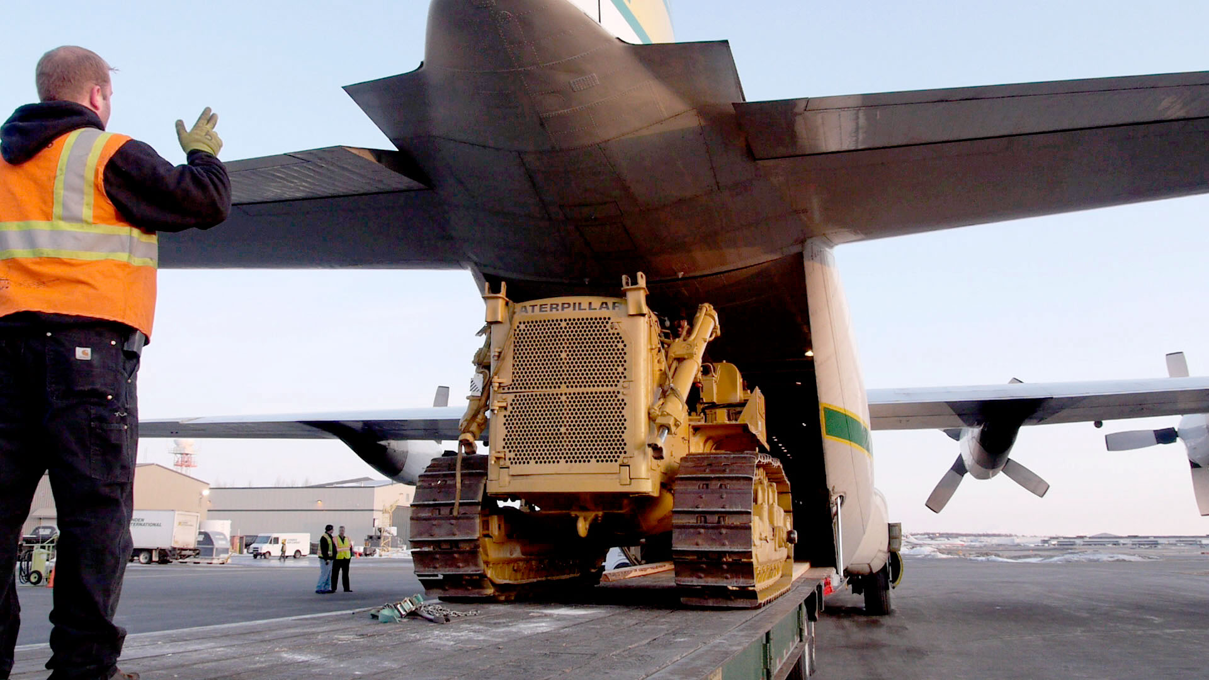
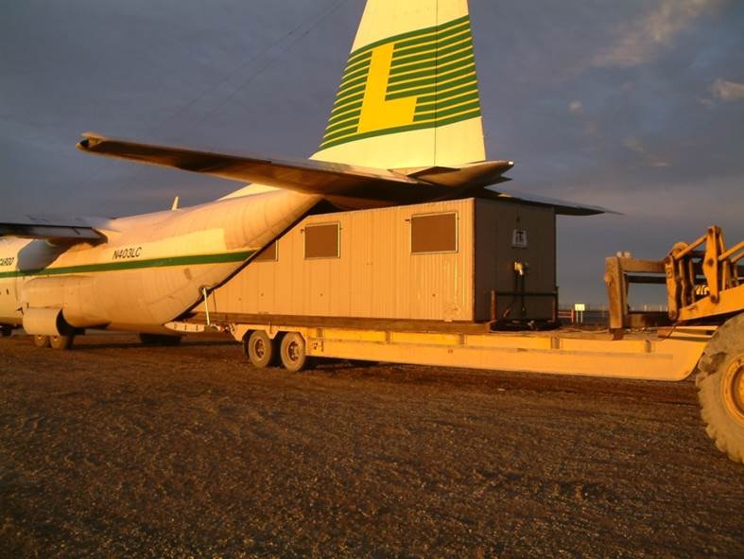

Slide 19
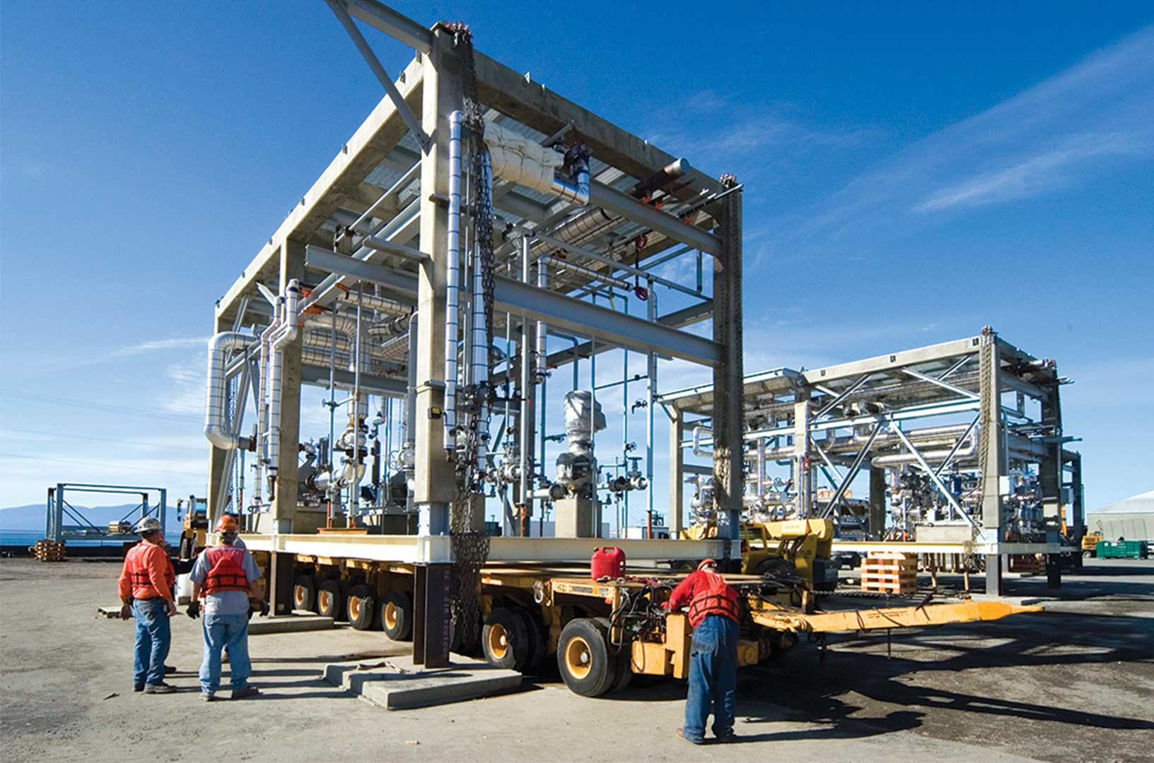

Slide 20
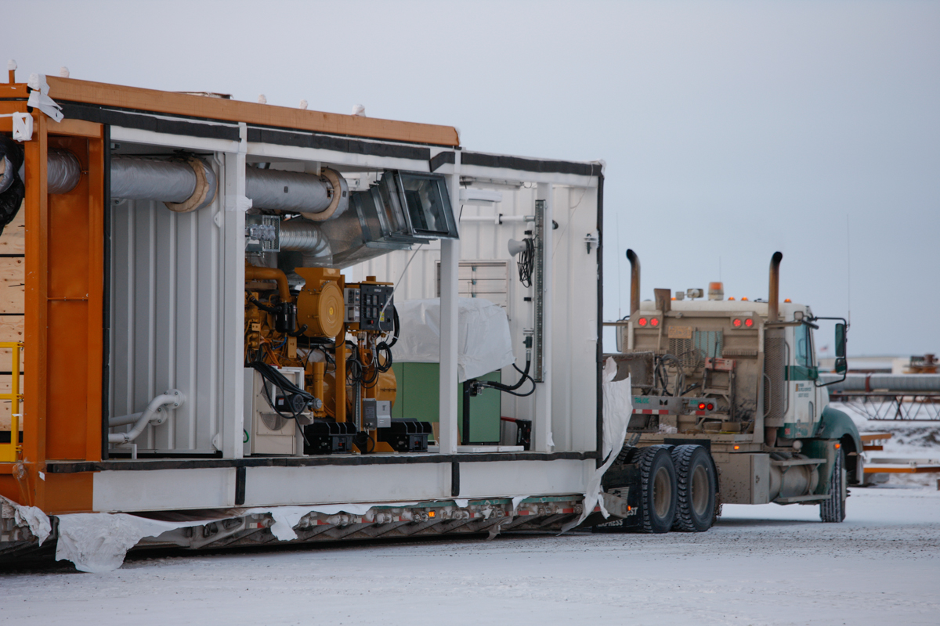

Slide 21
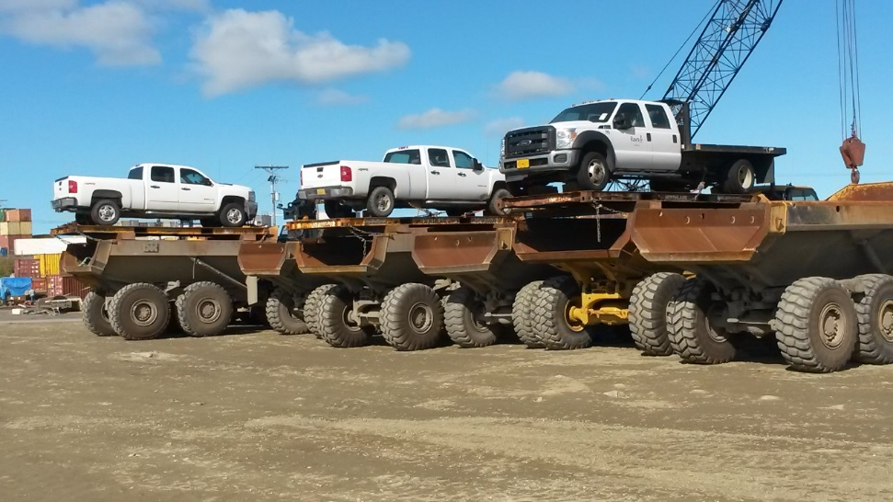
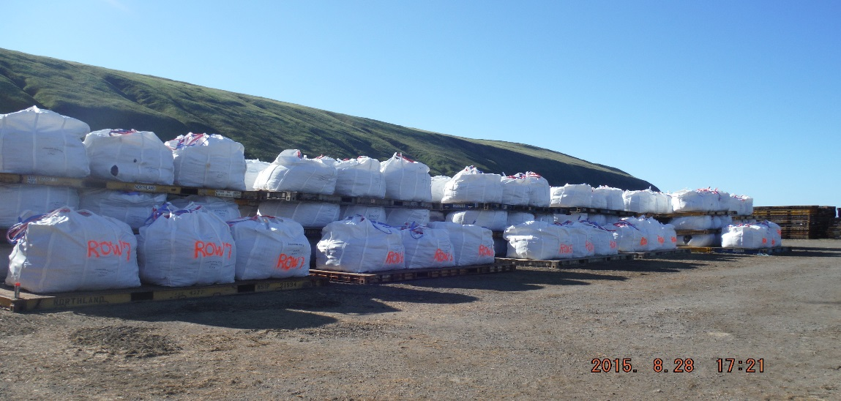

Slide 22
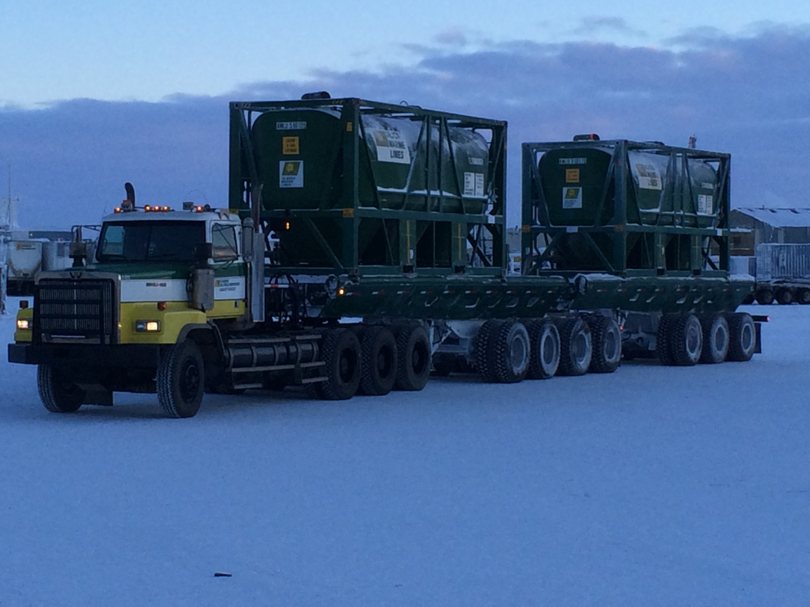

Slide 23
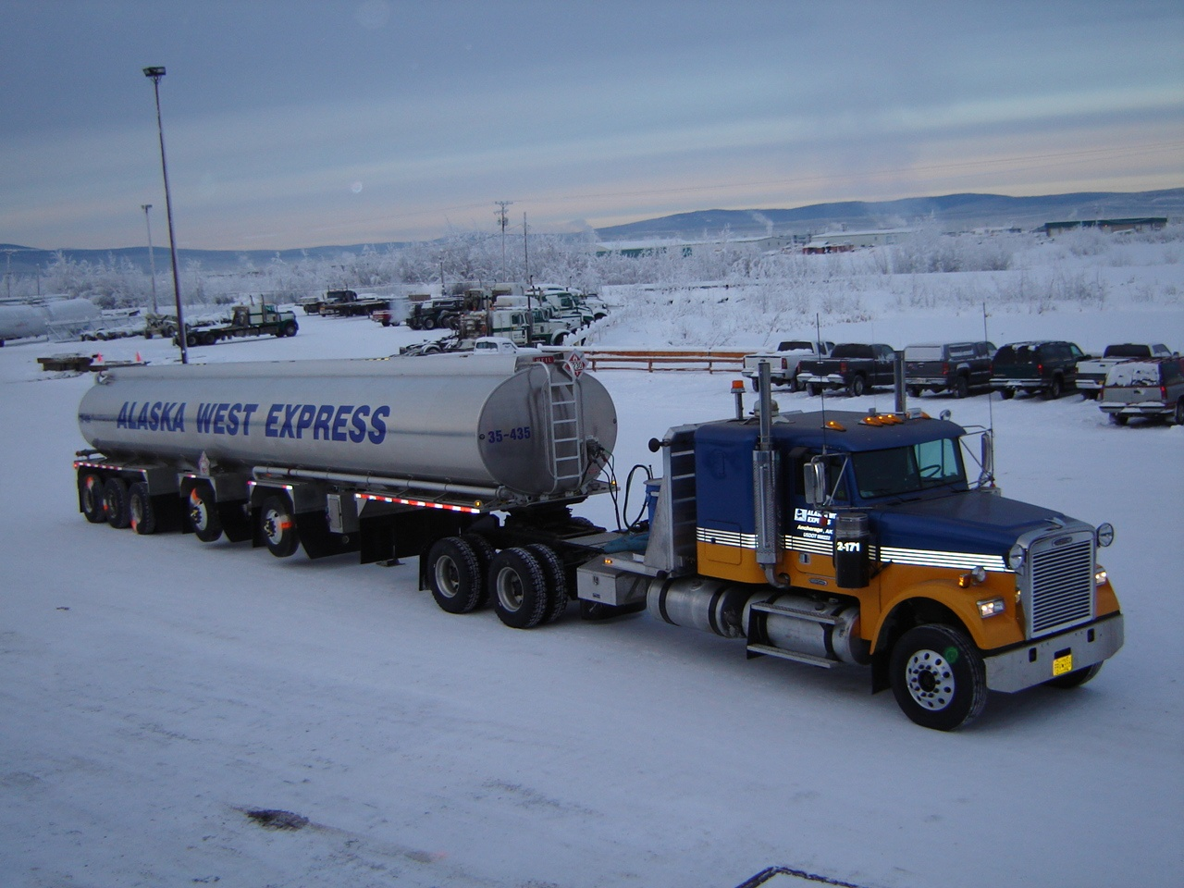

Slide 24
